Slide 1


Check if two graphs are isomorphic
Team Members:
Kollapudi Jeevan kumar – 2010030305
Indla Harshitha – 2010030300
Sumanth – 2010030051
P . Arun tej - 2010030262

Slide 2
Abstract
Graph isomorphism is an equivalence relation on graphs and as such it partitions the class of all graphs into equivalence classes.
A set of graphs isomorphic to each other is called an isomorphism class of graphs.
Two graphs G₁ and G₂ are said to be isomorphic if −
Their number of components (vertices and edges) are same.
Their edge connectivity is retained.

Slide 3
Introduction
Graph Isomorphism is the problem of determining whether two graphs are, in a structural sense, the same graph.
Determining the computational complexity status of the Graph Isomorphism problem is an unsolved problem in Computer Science.
It is unknown whether this problem can be solved quickly (i.e., in polynomial time) or whether the problem belongs to a class of difficult problems (NP-Complete).
Graph theory relates to computer science in two ways; first, graph theory may be applied to many aspects of computer science from data structures to parse trees, and second, many problems in graph theory reveal limits of what can be solved by a computer . Thus, computer scientists often search for algorithmic solutions to graph problems.

Slide 4
Literature review
A graph [8] is considered to be an ordered pair G = (N, L) if it has a set of N nodes with a corresponding set of L links, which are subsets with two elements of N.
The types of graphs are discussed in the following sub-sections:
Undirected Graphs
Directed Graph
Mixed Graph
Simple Graph
Multigraph
Directed Multigraph
Weighted Graph
Pseudograph

Slide 5
The graph theory has been extensively used in social network analyses owing to its representational capacity and simplicity.
Basically, all graphs consist of nodes (N) and connections (C), which connect the nodes.
The following are the basic components of the graph theory:
Dyad
Triad
Group
Sub-group
Relationship

Slide 6
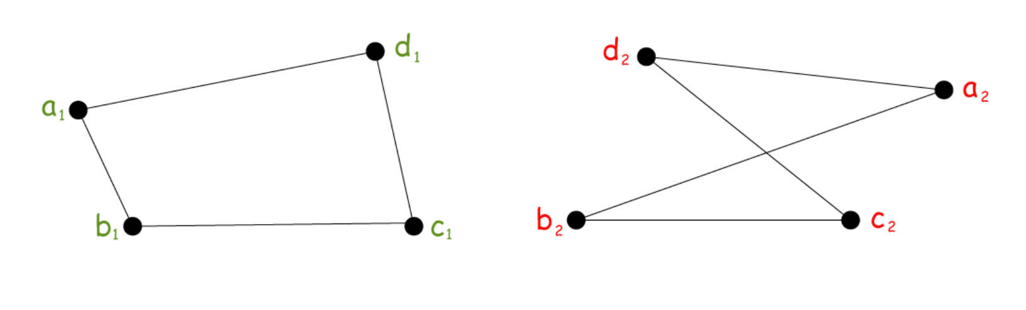
Methods
Method One – Checklist
How To Tell If Two Graphs Are Isomorphic
If number of vertices in both graphs the same
If number of edges in both graphs the same
If the degree sequence in both graphs the same
If the vertices in one graph can form a cycle of length k, can we find the same cycle length in the other graph? Yes, each graph has a cycle of length 4.

Slide 7
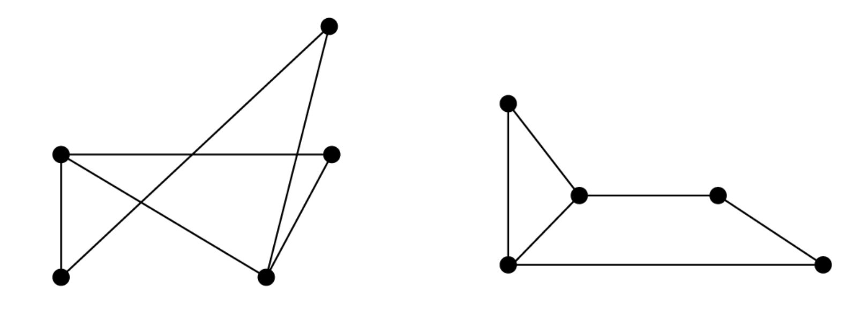
Method Two – Relabelling
In addition to counting vertices, edges, degrees, and cycles, there is another easy way to verify an isomorphism between two simple graphs: relabeling.
Suppose we want to show the following two graphs are isomorphic.
First, we check vertices and degrees and confirm that both graphs have 5 vertices and the degree sequence in ascending order is (2,2,2,3,3).
Now we methodically start labeling vertices by beginning with the vertices of degree 3 and marking a and b.

Slide 8
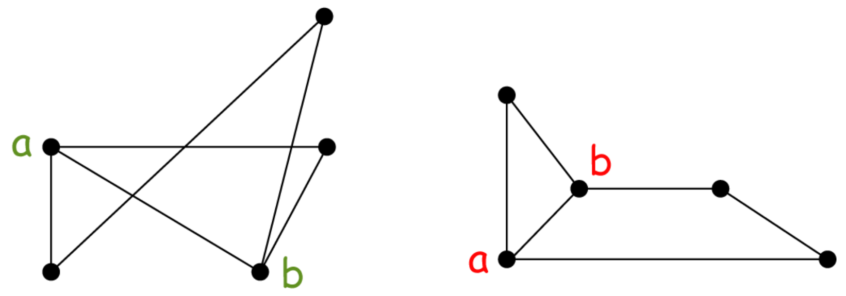
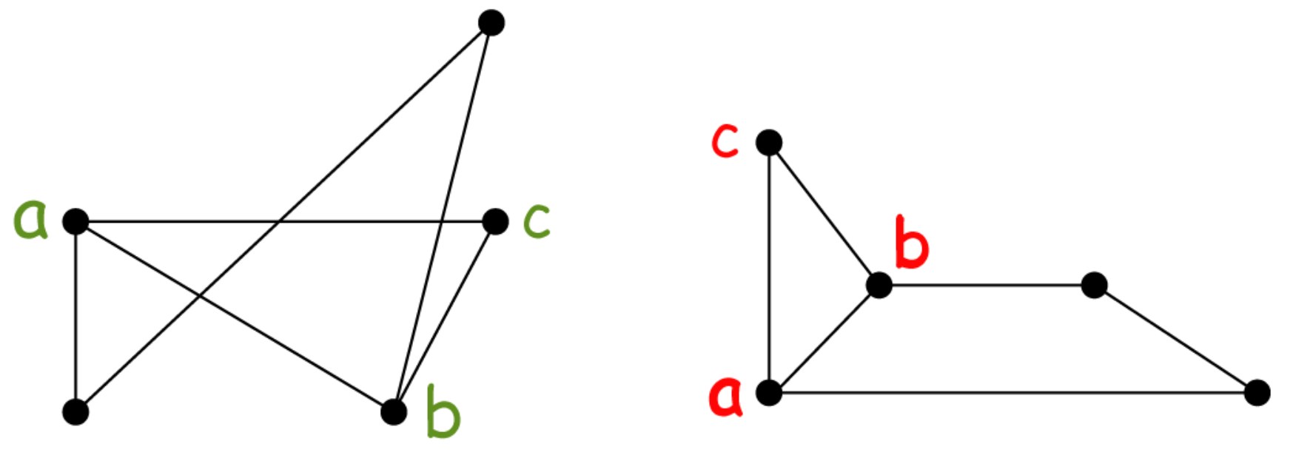
Next, we notice that in both graphs, there is a vertex that is adjacent to both a and b, so we label this vertex c in both graphs.
This now follows that there are two vertices left, and we label them according to d and e, where d is adjacent to a and e is adjacent to b.

Slide 9
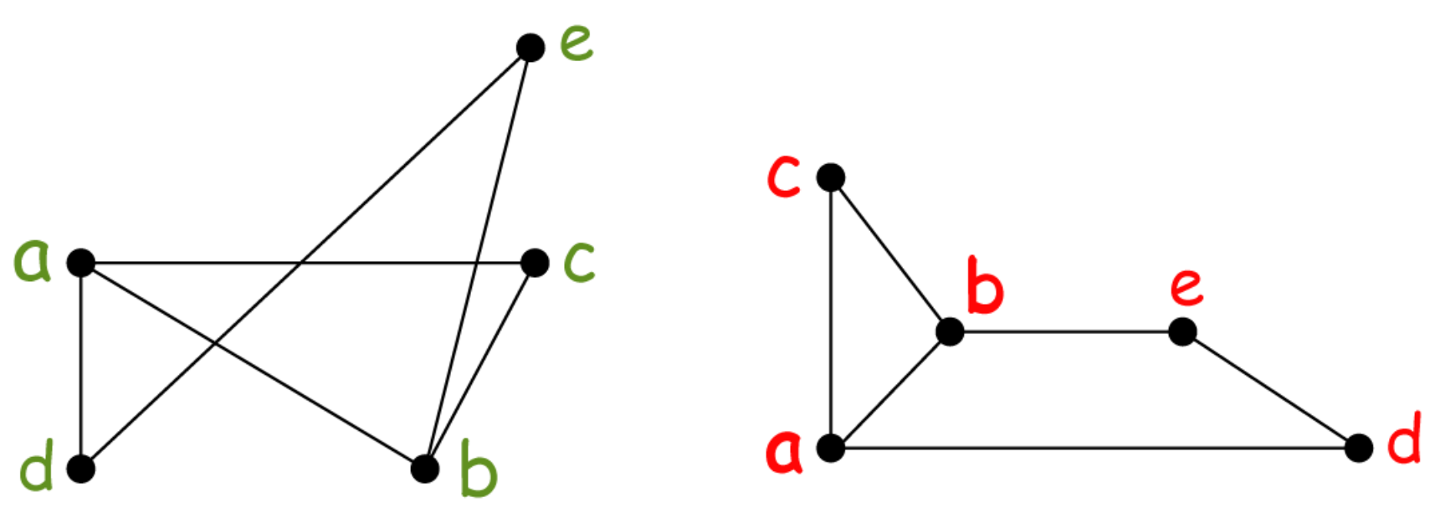
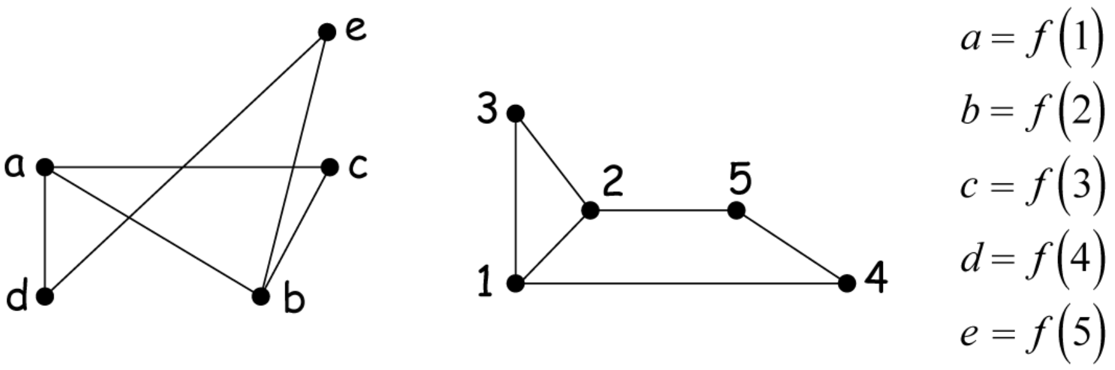
And finally, we define our isomorphism by relabeling each graph and verifying one-to-correspondence.

Slide 10
Algorithm
areIsomorphic(G1, G2):
if(G1.num_verticies != G2.num_verticies)
return False
if(G1.num_total_edges != G2.num_total_edges)
return False
for each vertex v in G1:
if( G2.find(v).edges != v.edges):
return False;
//Try and find a property in graph G1 that does not exist in G2.
// Use a heuristic. ie- try and find nonmutually adjacenct sets.

Slide 11
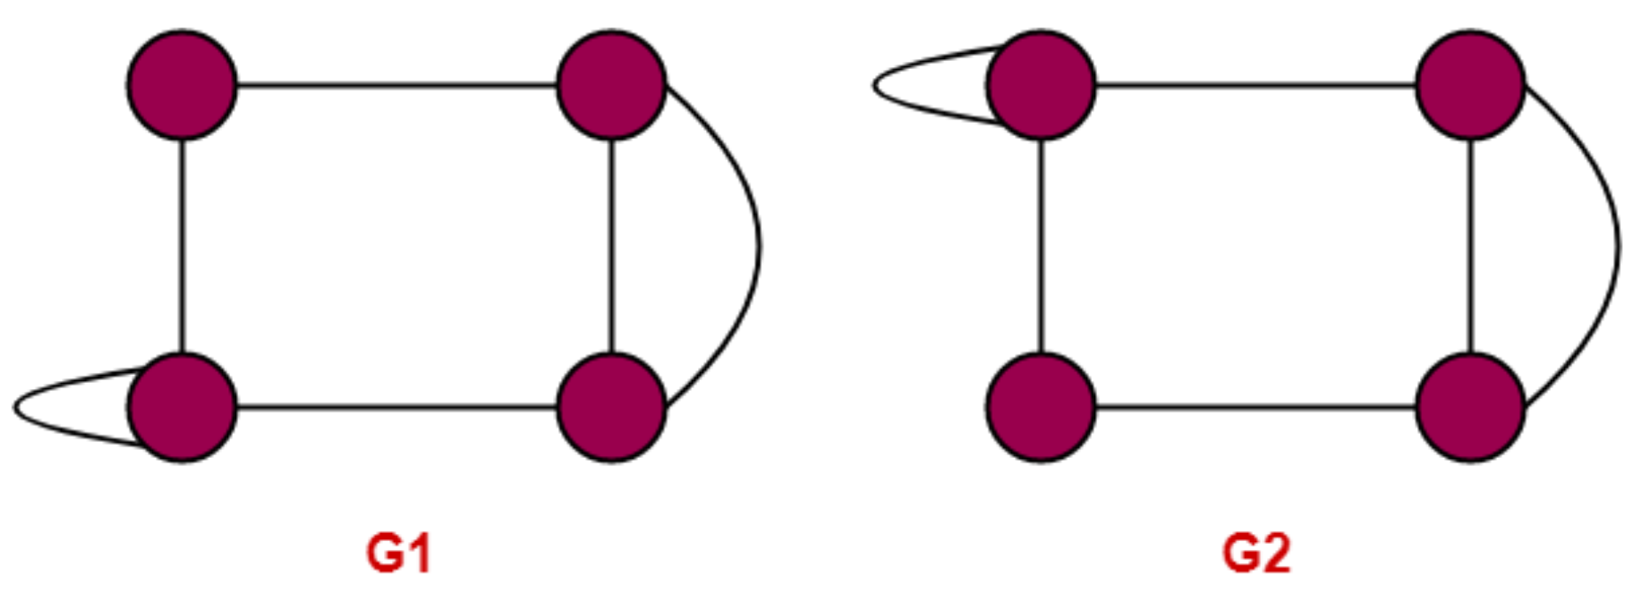
Result
Problem – 1
Checking Necessary Conditions-
Condition-01:
Number of vertices in graph G1 = 4
Number of vertices in graph G2 = 4
Here,
Both the graphs G1 and G2 have same number of vertices.
So, Condition-01 satisfies.

Slide 12
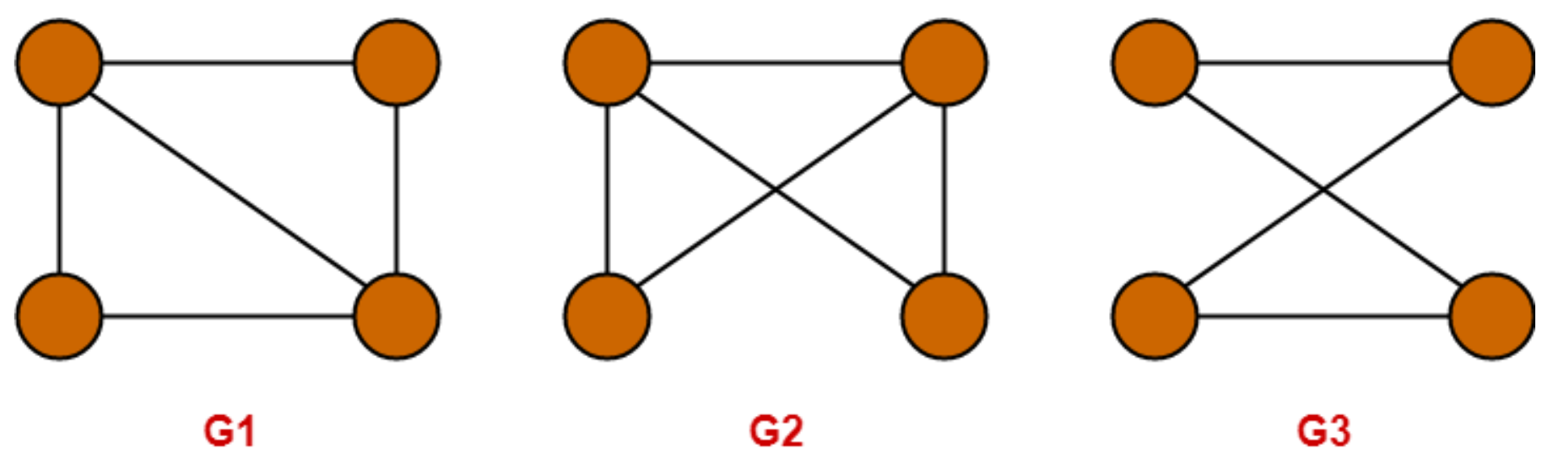
Condition-02:
Number of edges in graph G1 = 5
Number of edges in graph G2 = 6
Here,
Both the graphs G1 and G2 have different number of edges.
So, Condition-02 violates.
Since Condition-02 violates, so given graphs can not be isomorphic.
∴ G1 and G2 are not isomorphic graphs.
Problem – 2

Slide 13
Checking Necessary Conditions-
Condition-01:
Number of vertices in graph G1 = 4
Number of vertices in graph G2 = 4
Number of vertices in graph G3 = 4
Here,
All the graphs G1, G2 and G3 have same number of vertices.
So, Condition-01 satisfies.
Condition-02:
Number of edges in graph G1 = 5
Number of edges in graph G2 = 5
Number of edges in graph G3 = 4

Slide 14
Here,
The graphs G1 and G2 have same number of edges.
So, Condition-02 satisfies for the graphs G1 and G2.
However, the graphs (G1, G2) and G3 have different number of edges.
So, Condition-02 violates for the graphs (G1, G2) and G3.
Since Condition-02 violates for the graphs (G1, G2) and G3, so they can not be isomorphic.
∴ G3 is neither isomorphic to G1 nor G2.
Since Condition-02 satisfies for the graphs G1 and G2, so they may be isomorphic.
∴ G1 may be isomorphic to G2.
Now, let us continue to check for the graphs G1 and G2.
Condition-03:
Degree Sequence of graph G1 = { 2 , 2 , 3 , 3 }
Degree Sequence of graph G2 = { 2 , 2 , 3 , 3 }

Slide 15
Here,
Both the graphs G1 and G2 have same degree sequence.
So, Condition-03 satisfies.
Condition-04:
Both the graphs contain two cycles each of length 3 formed by the vertices having degrees { 2 , 3 , 3 }
It means both the graphs G1 and G2 have same cycles in them.
So, Condition-04 satisfies.
Thus,
All the 4 necessary conditions are satisfied.
So, graphs G1 and G2 may be isomorphic.
Now, let us check the sufficient condition.

Slide 16
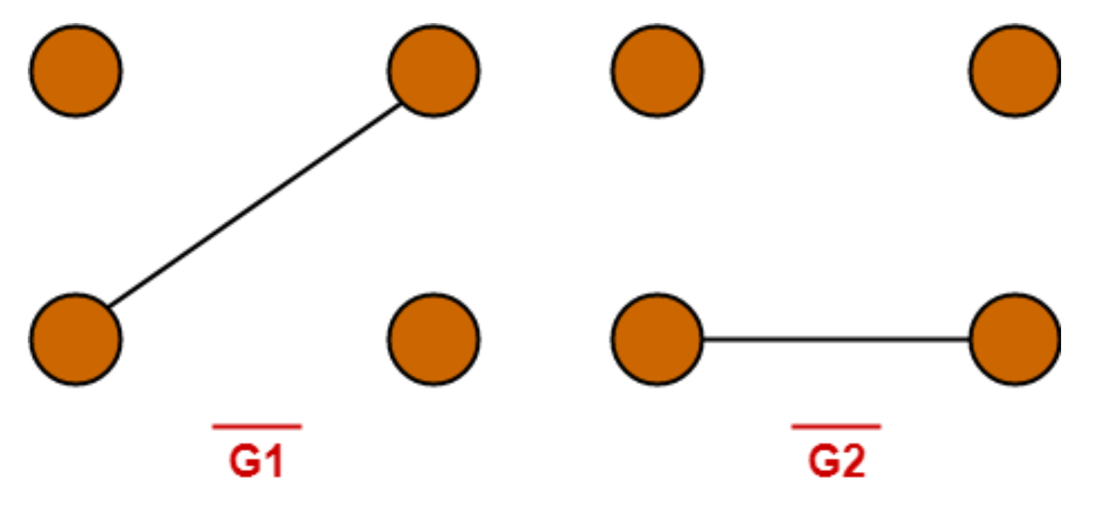
Checking Sufficient Condition-
We know that two graphs are surely isomorphic if and only if their complement graphs are isomorphic.
So, let us draw the complement graphs of G1 and G2.
The complement graphs of G1 and G2 are-
Clearly, Complement graphs of G1 and G2 are isomorphic.
∴ Graphs G1 and G2 are isomorphic graphs.

Slide 17
Discussion
Graphs are mathematical models used for visual representation of data.
As discussed above, node and connections are the two components of a graph, which has different types.
One of the structural similarities of two or more (sub)graphs is known as graph isomorphism.
Therefore, there are algorithms employed to verify the similarities discussed previously, as well as the areas where this is applicable.

Slide 18
Conclusion
A graph analysis focuses on investigating any data representation as vertices and edges not only to visualize but also locate and extract hidden insights from such representation.
An isomorphic graph was intensively reviewed in this research.
Thus, the algorithm used in this type of graph analysis (both old and recent ones) was reviewed, each algorithm was stated, pros and cons were discussed and various fields of application were identified.
The result showed that the (sub)graph isomorphism is a useful technique for graph analysis and is applicable to numerous real-life cases.
This research highlighted the need, use and importance of the sub(graph) isomorphism in detail.

Slide 19

Thank You

